Slide 1
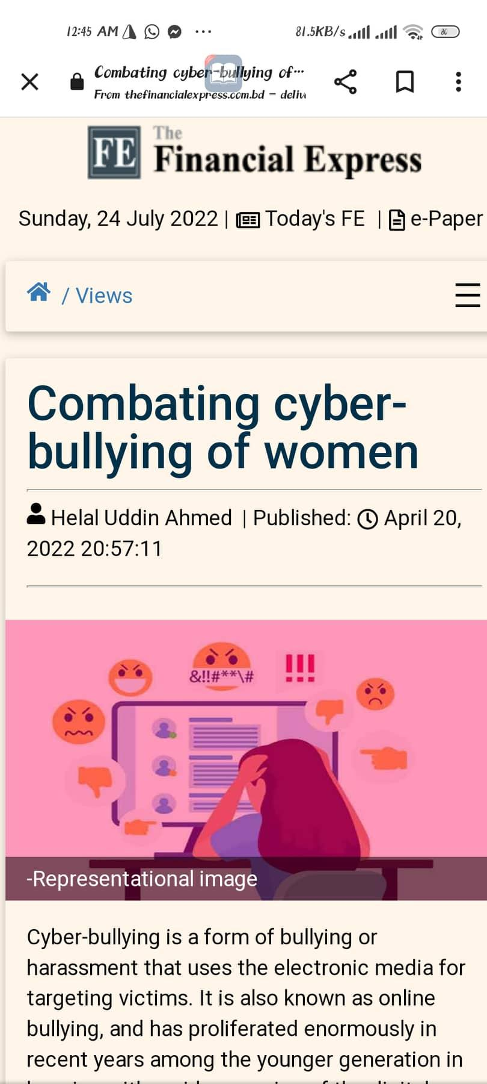
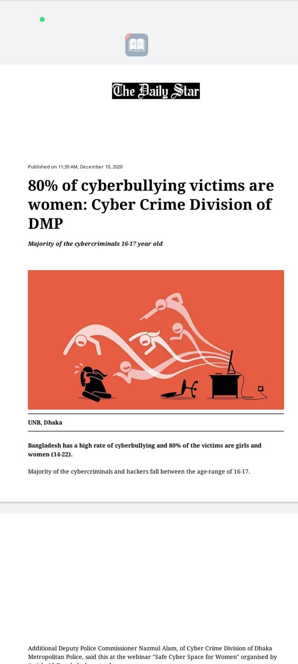
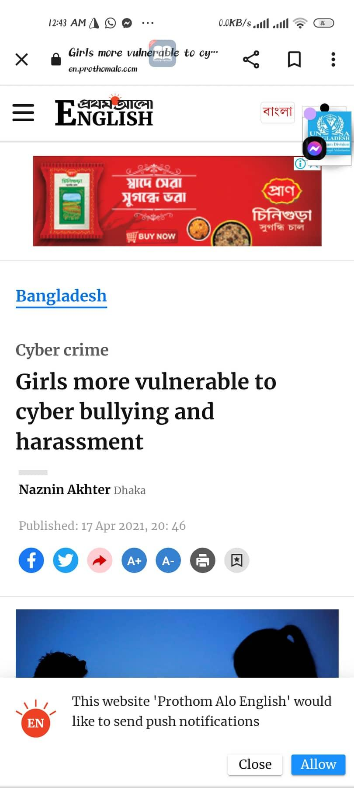

Problem Statement
According to ICT Ministry, 64% women victimized on sexual harrassment on 2021

Slide 2

Campaign Name
“What to do!”

Slide 3
Solution
Know
Refrain
Prevent
1
2
3

Slide 4
Smart Goal
Topic
31.4K
Institute
Cyber Bullying
Minimum youth will be reached.
Different schools, and colleges.
Time
Medium
Project 2 Months
Online and Offline.

Slide 5
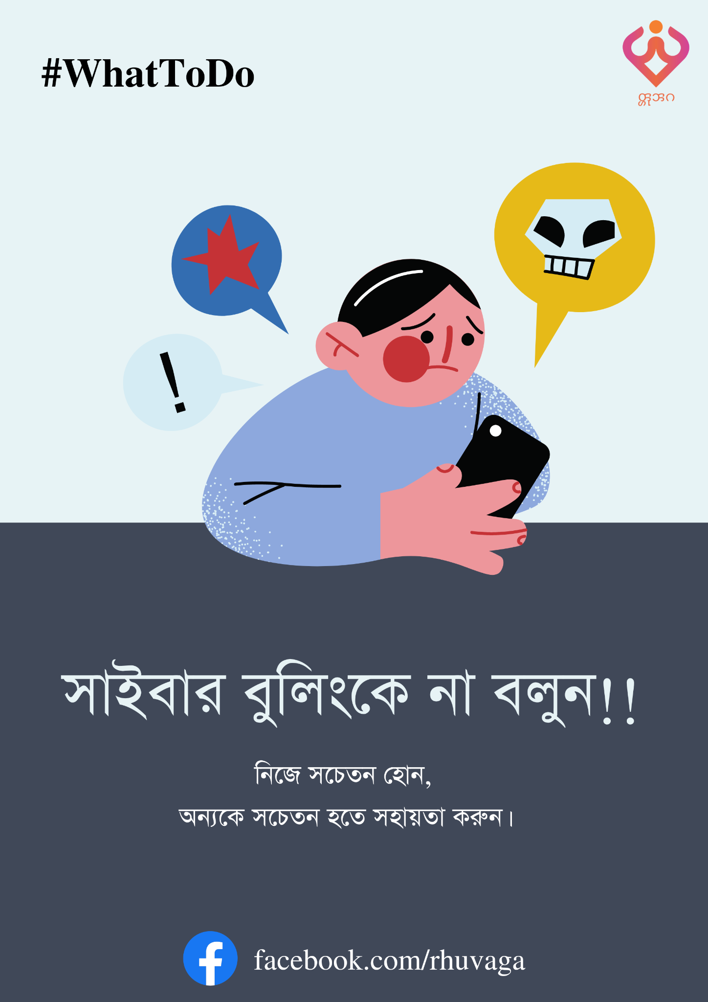


Activities in Offline
Postering
Seminars
Wall Painting

Slide 6






Activities in Online
Static Content
Video Content
Survey
Live Consultancy

Slide 7



Targeted People
Educational Institution
of
Rangamati
Youth (16-35)
Local Community

Slide 8
Impact
30K
Online
Offline
1.4K
Total Engagement : 31.4 K

Slide 9


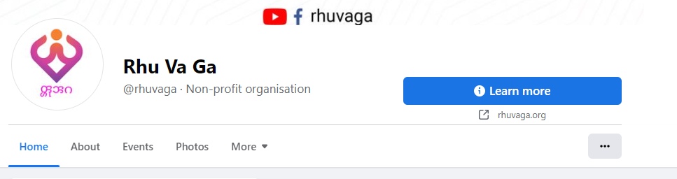
Why Us!
Website
Facebook Page

Slide 10
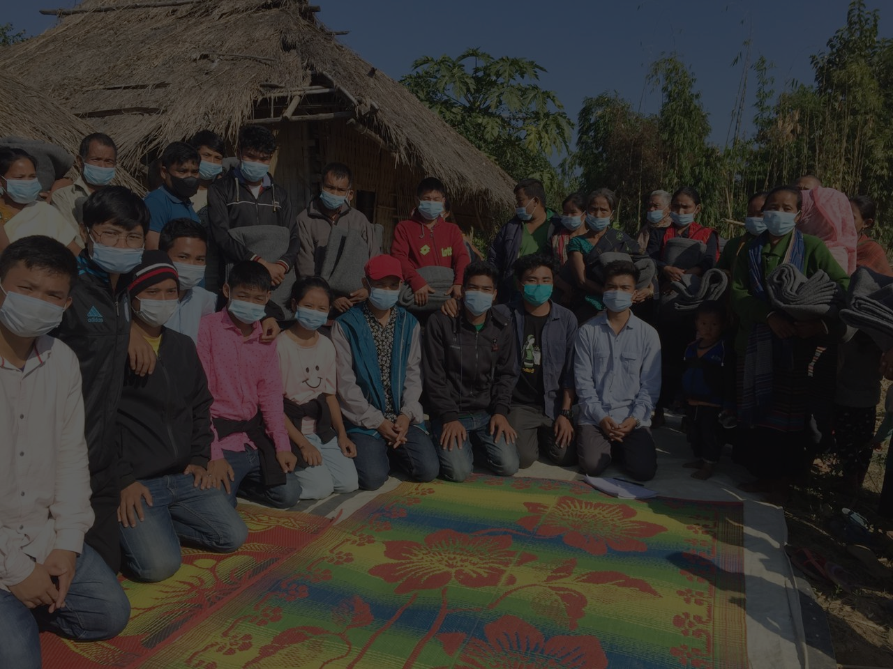
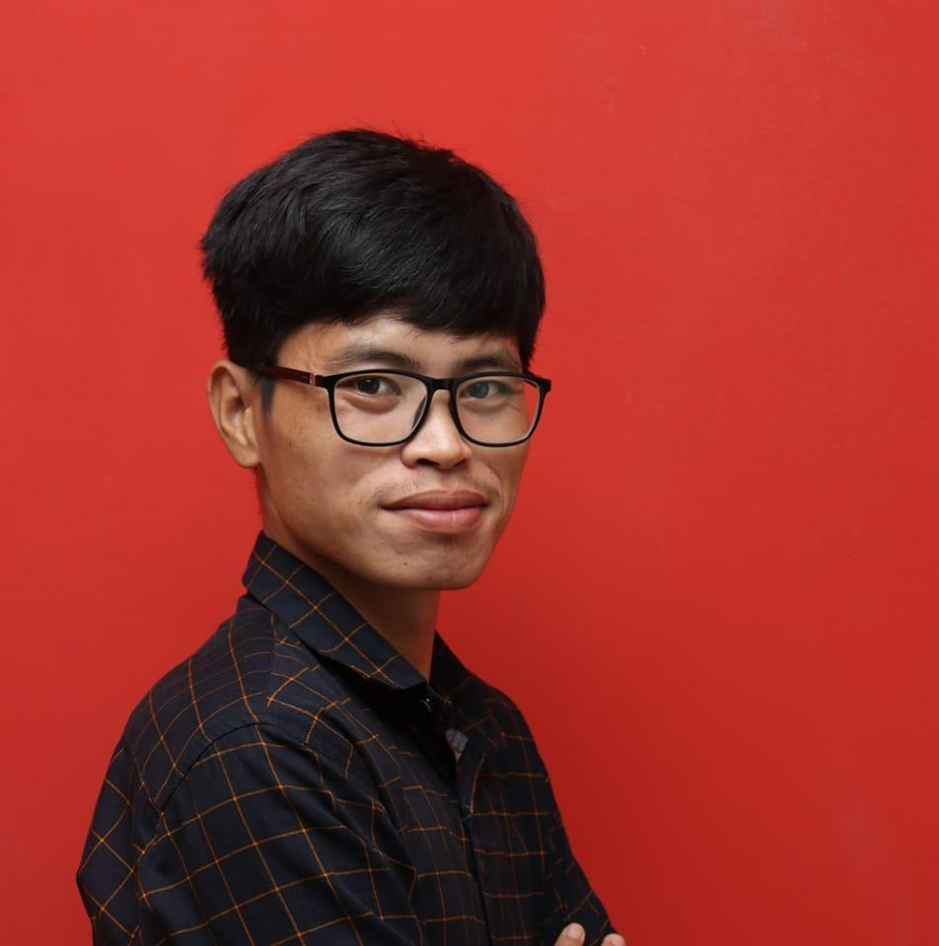
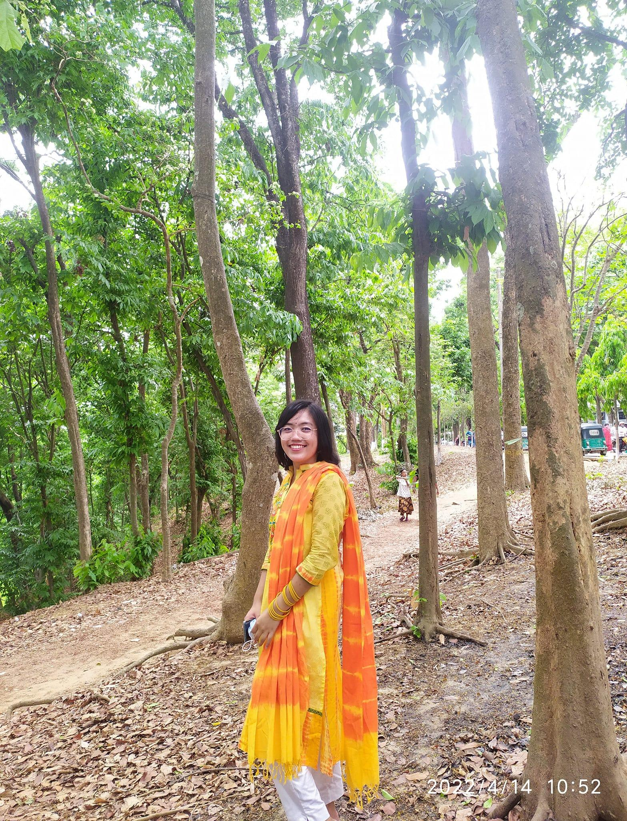
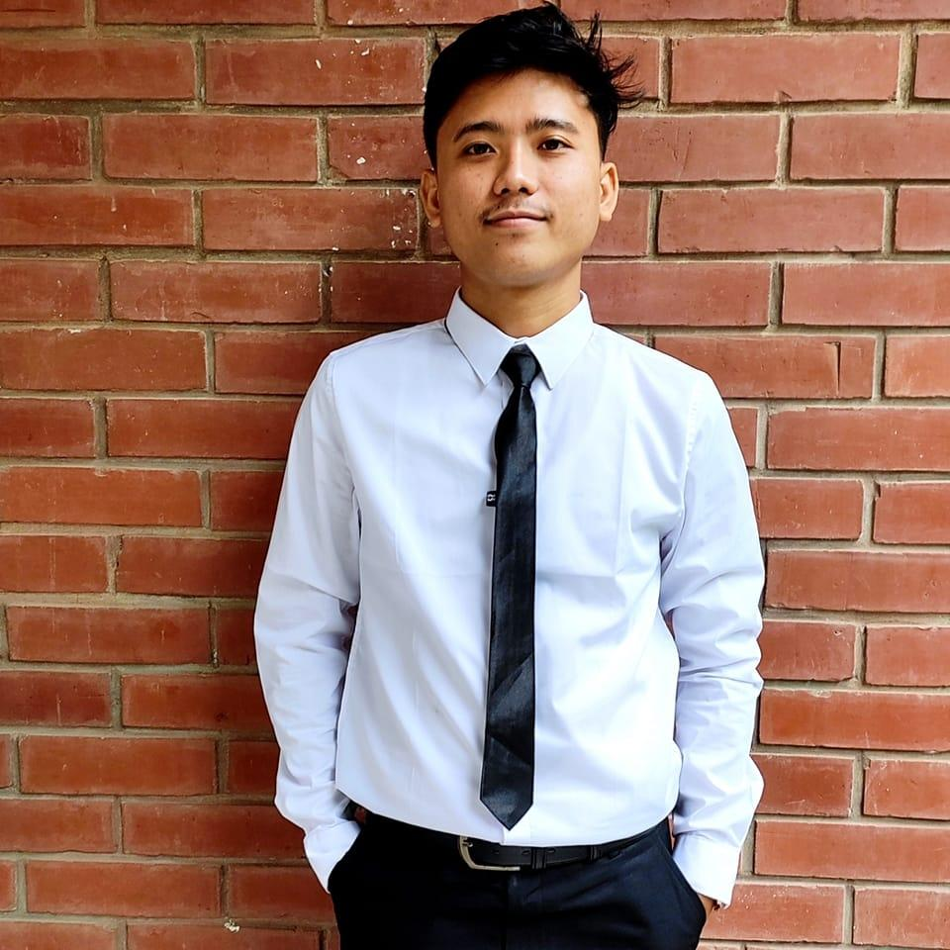
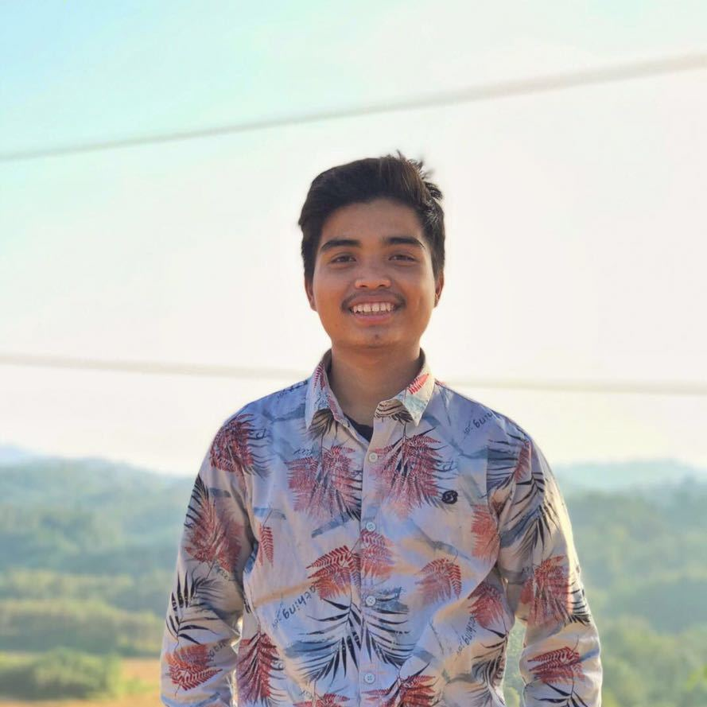
Team Expertise
Sohag Khisa
Trainer, Video Maker
Adeti Dewan
Cultural Activist
Gagan Chakma
Creative Planner & Manager
Vaskar Chakma
IT Expert, Graphics Designer
Rhukkengor Valedeer Gabusya (RhuVaGa)

Slide 11
Timeline
Offline
Postering for making people aware about Cyber Bullying.
Offline
Wall painting for social awareness about Cyber Bullying by own Artist.
2nd 20 Days
1st 20 Days
3rd 20 Days
1st Survey
Offline
Arranging for seminars at different schools and colleges.
Online
Two Live Sessions with Lawyers & Law Enforcement Authority.
2nd Survey

Slide 12
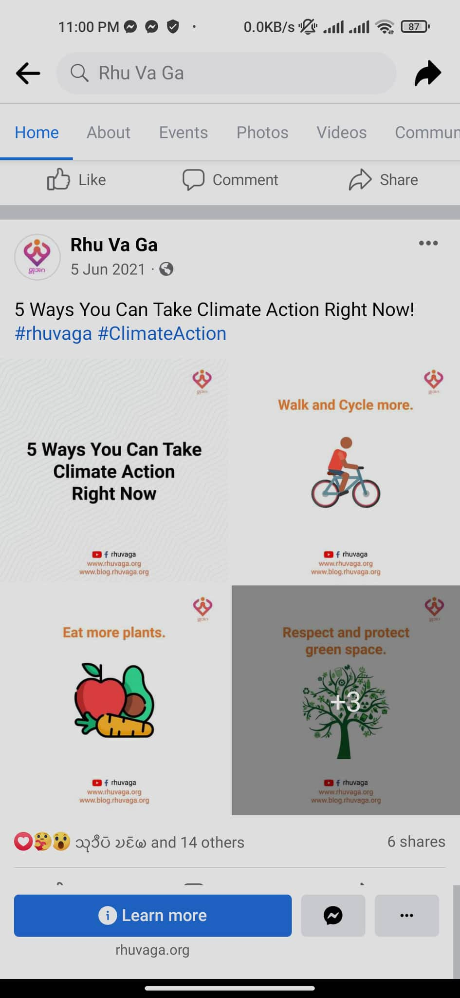
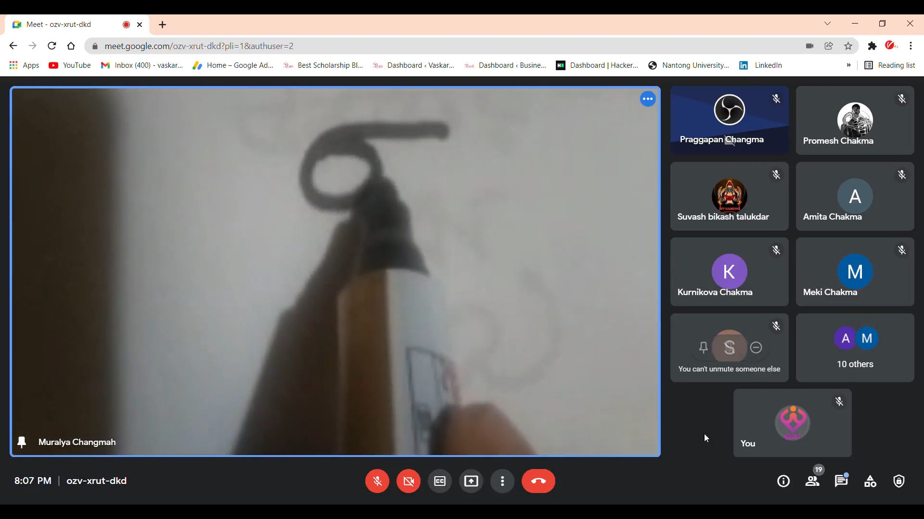
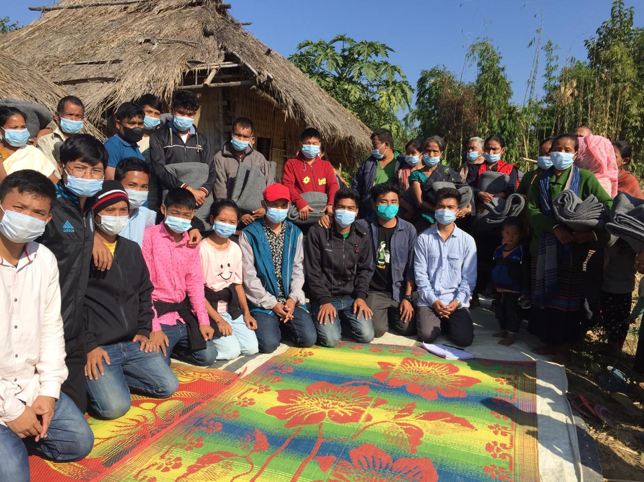

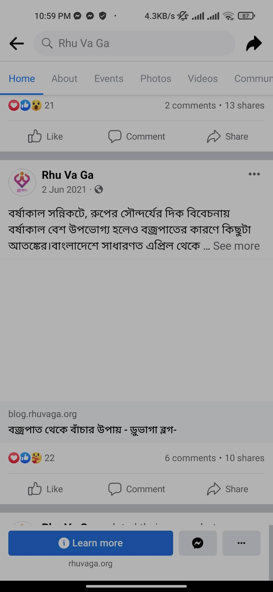



Previous Projects
Climate Action
Chakma Language Course
Warmness For the Marginalized
Live Session
Blog Post
Chakma Dagho Hoda
Apni ki Janen ?
Ajker Ei Din e!

Slide 13
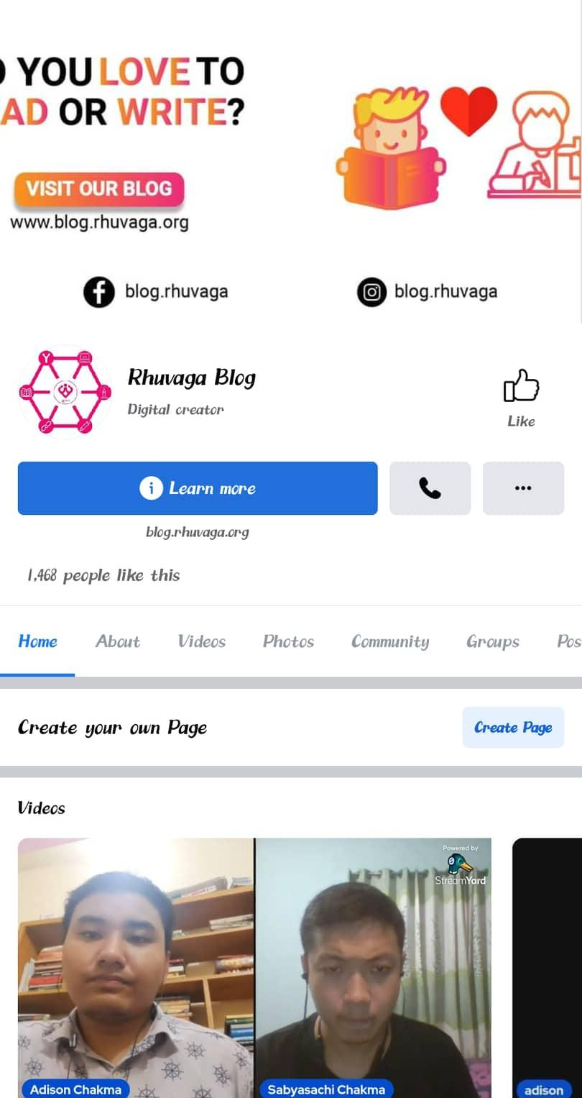


Running Projects
Upcoming Projects
RhuVaGa Blog
Small Business
(Buy & Sell)
Chakma Language Course Season - 3

Slide 14
Thank You!!

